Slide 1
Blood Pressure Detection

Slide 2
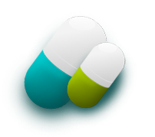
Table of Contents
Introduction
What is blood pressure?
Ways to Measure Blood Pressure
Dataset
Methods
Results
Conclusion
References

Slide 3
Introduction
blood pressure (BP) is a major risk factor for cardiovascular diseases (CVD).
ML and AI have also been employed in clinical research studies on BP.
Our study based on machine learning technique, is investigated to predict the
systolic blood pressure by correlated variables (Level of Hemoglobin, Genetic
Pedigree Coefficient, exercise, BMI, Age ,Sex , Pregnancy ,Smoking ,Physical activity
salt content in the diet , alcohol consumption per day , Level of Stress , Chronic kidney disease ,
Adrenal and thyroid disorders ).
The body has mechanisms to alter or maintain blood pressure by specialized
nerve cells called baroreceptors.

Slide 4
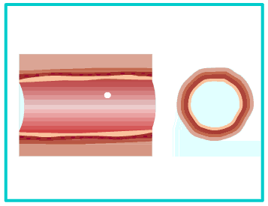
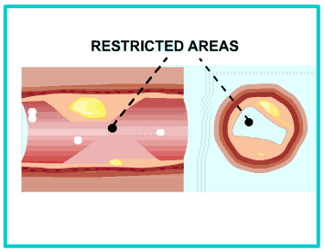
What is blood pressure?
Definition :-
blood pressure is the force
Exerted by the blood against the wall of blood vessel.

Slide 5
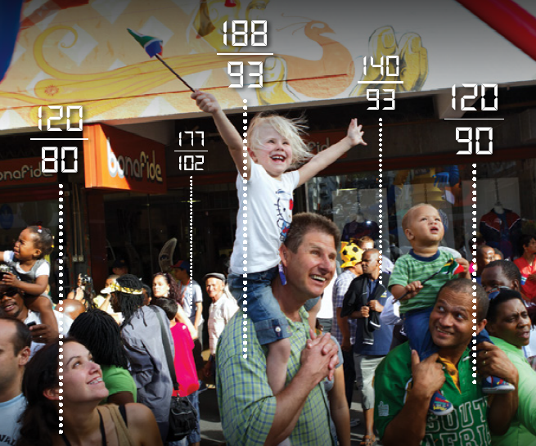
What is blood pressure?
Top number (systolic)
-measures the force of blood on arteries when the heart beats
120/80
Bottom number (diastolic)
- measures force of blood on arteries between beats

Slide 6
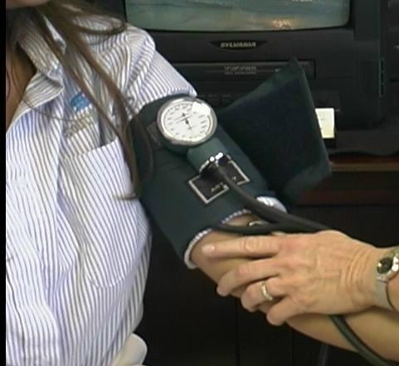
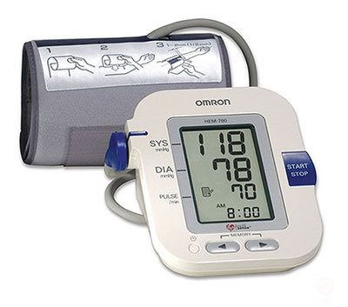
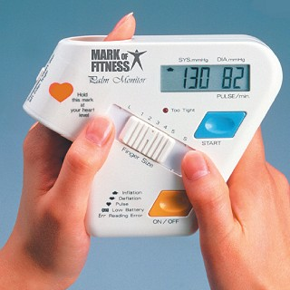
Ways to Measure Blood Pressure
3 Ways to Measure Blood Pressure
Aneroid Monitor
Finger/Wrist Monitor
Digital Monitor

Slide 7
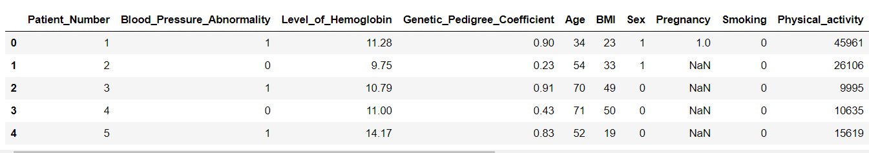
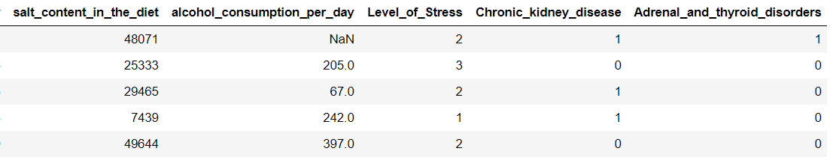
Dataset
Dataset link : https://www.kaggle.com/pavanbodanki/blood-press

Slide 8
Methods
Row Data
Data Pre-processing
Splitting the data into (train - validation –
test)
Use these models
(Gradient Boosting
Adaptive Boosting
Random Forest
Naive Bayes
Decision Tree
SVC
Extra Trees
Voting
Bagging
Logistic Regression)
Feature Scaling
Comparing results
Testing by the best model
Save model

Slide 9
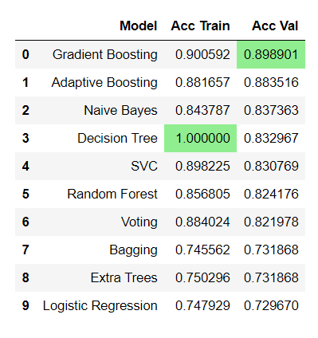
Results

Slide 10
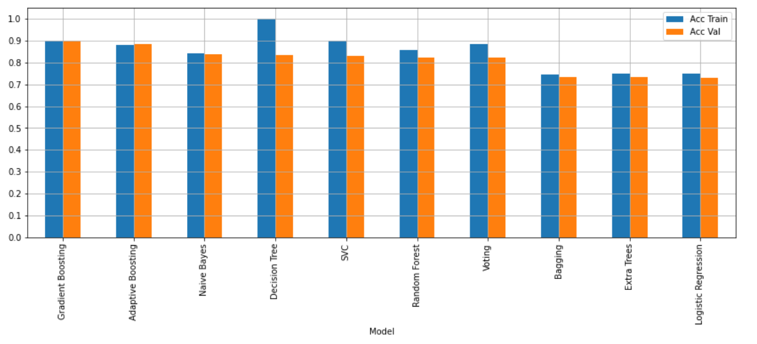
Results
After Doing Classification Algorithms We Found that Gradient Boosting
Algorithm is the best so we test it .

Slide 11
Results
Precision:
0.9088235294117647
Recall: 0.8607242339832869
F1Score: 0.8841201716738197
Accuracy of Test: 0.8842857142857142

Slide 12
Conclusion
No one can deny that high blood pressure is one of the chronic diseases of this age.
Therefore, it was necessary to machine learning a role in contributing to the solution
and discovery of this disease of time.
There are many and many researches in the machine learning that contribute to the
treatment of this disease.
No one denies that machine learning and medicine are two sides of the same coin.

Slide 13
References
https://onlinelibrary.wiley.com/doi/epdf/10.1111/jch.13700
https://www.researchgate.net/publication/282206874_Predicting_Systolic_Blood_Pressure_Using_Machine_Learning

Slide 14
THANK YOU

